Slide 1
Lecture 3
INT 222(Advanced Web Development)

Slide 2
Course Outline
Getting started with nodejs
Node Installation
ES6 Refresher
Node Basics
Modules in Nodejs
Dealing with request and responses in node
Rendering View pages
Working with express
Template Engines
Getting familiar with MongoDB

Slide 3
Session and cookies
Input Validations
File upload
Rest APIS
Web sockets(chat applications ,Real time applications)
Deployment

Slide 4
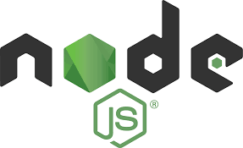
Node.js
Node.js was developed by Ryan Dahl in 2009.
Node.js is an open source, cross-platform run time environment to execute JavaScript code outside of a browser.

Slide 5
Node.js(contd.)
Since JavaScript was only run by the browser in HTML documents, Node.js was created.
Node.js allows you to write programs in JavaScript which can be run outside the browser.
Node.js is designed to build highly scalable, data-intensive and real-time applications.
Node.js is ideal for I/O-intensive applications.
Node. js is primarily used for non-blocking, event-driven servers, due to its single-threaded nature.
Notes:
Highly scalable - A "highly scalable" device or application implies that it can handle a large increase in users, workload or transactions without undue strain.
Data intensive - To process large volumes of data typically terabytes or petabytes in size and typically referred to as big data.
I/O intensive – That requires a lot of network and disk access.
With node js, you can serve more clients without using more hardware.

Slide 6
Node.js(contd.)
Node.js also provides a rich library of various JavaScript modules which simplifies the development of web applications using Node.js to a great extent.
Notes:
Highly scalable - A "highly scalable" device or application implies that it can handle a large increase in users, workload or transactions without undue strain.
Data intensive - To process large volumes of data typically terabytes or petabytes in size and typically referred to as big data.
I/O intensive – That requires a lot of network and disk access.
With node js, you can serve more clients without using more hardware.

Slide 7
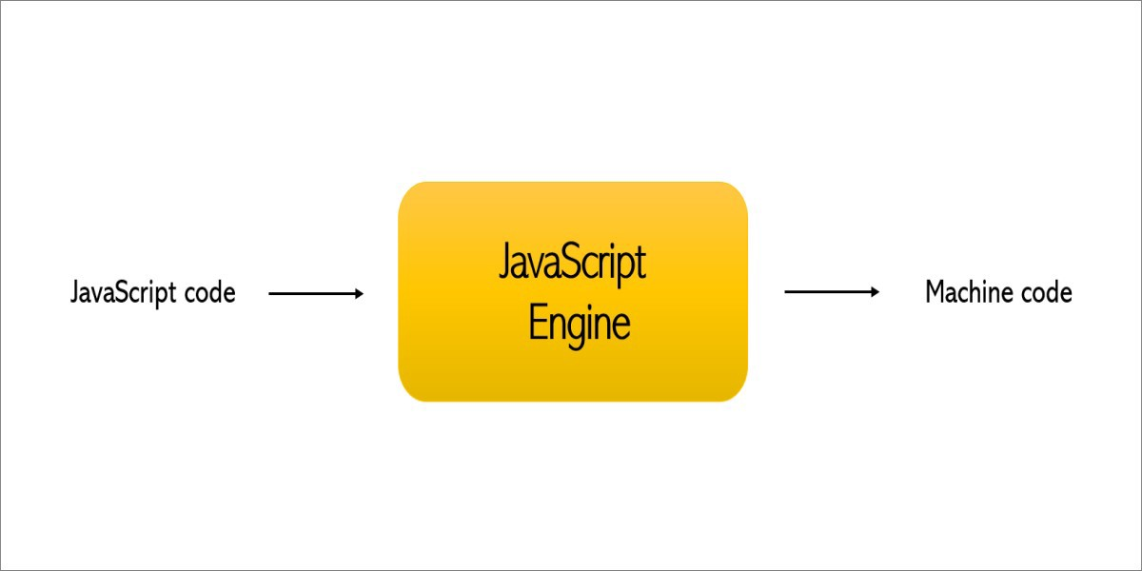
Node.js(contd.)
Node.js is a JavaScript runtime built on Chrome's V8 JavaScript engine.
A JavaScript engine is a program which executes JavaScript code.

Slide 8
Node.js(contd.)
V8 — open source, developed by Google, written in C++
Rhino — managed by the Mozilla Foundation, open source, developed entirely in Java
Chakra — Microsoft Edge
Nitro-Safari

Slide 9
Node.js(contd.)
Why was the V8 Engine created?
The V8 Engine which is built by Google is open source and written in C++.
This engine is used inside Google Chrome.
Unlike the rest of the engines, however, V8 is also used for the popular Node.js runtime.

Slide 10
Node js architecture
Chrome
Node js
V8
V8
Notes:
Before node js, we had the JavaScript apps that would run only inside a browser. Every browser has a JS Engine that takes the JS code and converts it into a code that a computer can understand. In 2009, Ryan Dahl came up with an idea to execute JS code outside of a browser, so he took the Google’s V8 engine(fastest engine) and then embedded it inside a C++ code. So, Node js actually consists of a JS engine to execute the JS code.
But we have different objects in Node js, not like document or window object as we have in browsers. Eg, we can have fs.readFile(), http.createServer().
So node js contains V8 engine and some additional capabilities which are not possible with a browser. Both Chrome and browser share the same JS engine but provide different run time environment to run JS. Node is a run time environment and not a programming language or a framework.

Slide 11
Nodejs is not a language,
Not a library
Not a framework
Its simply a runtime environment

Slide 12
Traditional web server model
In the traditional web server model, each request is handled by a dedicated thread from the thread pool.
If no thread is available in the thread pool at any point of time then the request waits till the next available thread.
Dedicated thread executes a particular request and does not return to thread pool until it completes the execution and returns a response.

Slide 13
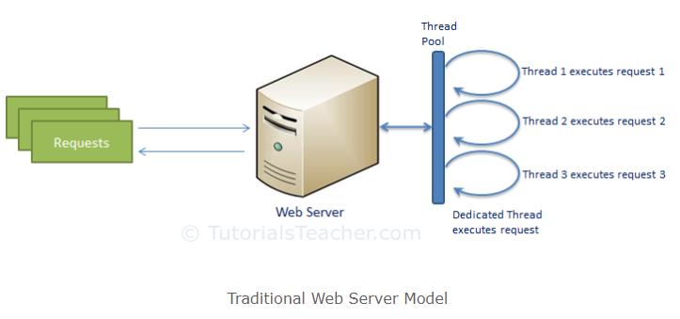
Traditional web server model(contd.)

Slide 14
Node.js model
Node.js processes user requests differently when compared to a traditional web server model.
Node.js runs in a single process and the application code runs in a single thread and thereby needs less resources than other platforms.
All the user requests to your web application will be handled by a single thread and all the I/O work or long running job is performed asynchronously for a particular request.

Slide 15
Node.js model(contd.)
So, this single thread doesn't have to wait for the request to complete and is free to handle the next request.
When asynchronous I/O work completes then it processes the request further and sends the response.
An event loop is constantly watching for the events to be raised for an asynchronous job and executing callback function when the job completes.

Slide 16
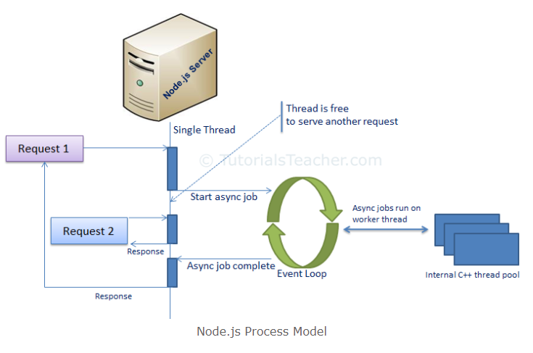
Node.js model(contd.)

Slide 17
Node.js model is asynchronous
A common task for a web server can be to open a file on the server and return the content to the client.
Here is how PHP or ASP handles a file request:
Sends the task to the computer's file system.
Waits while the file system opens and reads the file.
Returns the content to the client.
Ready to handle the next request.

Slide 18
Node.js model is asynchronous(contd.)
Here is how Node.js handles a file request:
Sends the task to the computer's file system.
Ready to handle the next request.
When the file system has opened and read the file, the server returns the content to the client.
Node.js eliminates the waiting, and simply continues with the next request.
Node.js runs single-threaded, non-blocking, asynchronously programming, which is very memory efficient.

Slide 19
Applications using node.js
Netflix
Paypal
LinkedIn
Yahoo
Mozilla
Uber
Ebay
Walmart
NASA

Slide 20
Features of node.js
Asynchronous and Event Driven − All APIs of Node.js library are asynchronous, that is, non-blocking. It essentially means a Node.js based server never waits for an API to return data. The server moves to the next API after calling it.
Very Fast − Being built on Google Chrome's V8 JavaScript Engine, Node.js library is very fast in code execution.

Slide 21
Features of node.js(contd.)
Single Threaded but Highly Scalable − Node.js uses a single threaded model with event looping. Event mechanism helps the server to respond in a non-blocking way and makes the server highly scalable as opposed to traditional servers which create limited threads to handle requests. Node.js uses a single threaded program and the same program can provide service to a much larger number of requests than traditional servers like Apache HTTP Server.

Slide 22
Features of node.js(contd.)
No Buffering − Node.js applications never buffer any data. These applications simply output the data in chunks.

Slide 23
Advantages of Node.js
Uses JavaScript to build entire server side application.
Lightweight framework that includes bare minimum modules. Other modules can be included as per the need of an application.
Performs faster than other frameworks.
Cross-platform framework that runs on Windows, MAC or Linux

Slide 24
Where not to use Node.js
Node.js is not fit for an application which performs CPU-intensive operations like image processing or other heavy computation work because it takes time to process a request and thereby blocks the single thread.

Slide 25
Course Outcomes
Describe server-side JavaScript in web application development.
Discuss the role of server side JavaScript in web application development.
Use MongoDB database with Node.js
Examine Node.js architecture to allow high scalability with asynchronous code
Assess web applications that use session management and object-oriented techniques
Construct rich interactive environments for the Web-based applications

